Slide 1
Data Warehousing and Data Mining

Slide 2
Introduction To Data Warehousing
Database-Collection of related data
- structured with defined schema
-Information organized in rows and columns
-Ex MySQL, ORACLE, SQL
Data Warehouse- Special type of database
- Analysis and report
- Support for Business Intelligence Activities
- Ex:How Much % percentage Discount
- MY SQL with Special Data warehouse

Slide 3
Condt
Data Lake- It is centralized repository that allows you to store all structured and unstructured data at any scale
Ex: AWS, Azure,BigQuery…

Slide 4
Database Vs Datawarehouse
S.No | Database | Datawarehouse
1. | Transactional Based | Analytical Based
2. | Used to Store data ,retrieve,.. | Used to Analysis data Prediction of data Decision support
3. | OLTP | OLAP
4. | Fundamental operation of business | Help to analyse the business
5. | Day to Day Processing | Historical Processing
6. | Relational Database | Multidimensional arrays

Slide 5
Features of DW
Subjected oriented-It provides information catered to a specific subject instead of the whole organization’s ongoing operations
Integrated-it is developed by combining data from multiple sources, such as flat files and relational databases, which offers better data analysis.
Time variant -The data in a DWH gives information from a specific historical point of time. The data is categorized with a particular time frame.
Non –volatile -Non-volatile refers to historical data that is not omitted when newer data is added.
-previous data is not erased when new data is entered in it

Slide 6
Datawarehouse Architecture
To design an effective and efficient data warehouse, we need to understand and analyze the business needs and construct a business analysis framework.
The top-down view allows the selection of the relevant information necessary for the data warehouse.
The data source view exposes the information being captured, stored, and managed by operational systems.
The data warehouse view includes fact tables and dimension tables.
business query view is the perspective of data in the data warehouse from end user. It is the view of the data from the viewpoint of the end-user.

Slide 7
Three-Tier Data Warehouse Architecture
Three layer/Tier
Bottom Tier (Data Warehouse Server)
Middle Tier (OLAP Server)
Top Tier (Front end Tools).

Slide 8
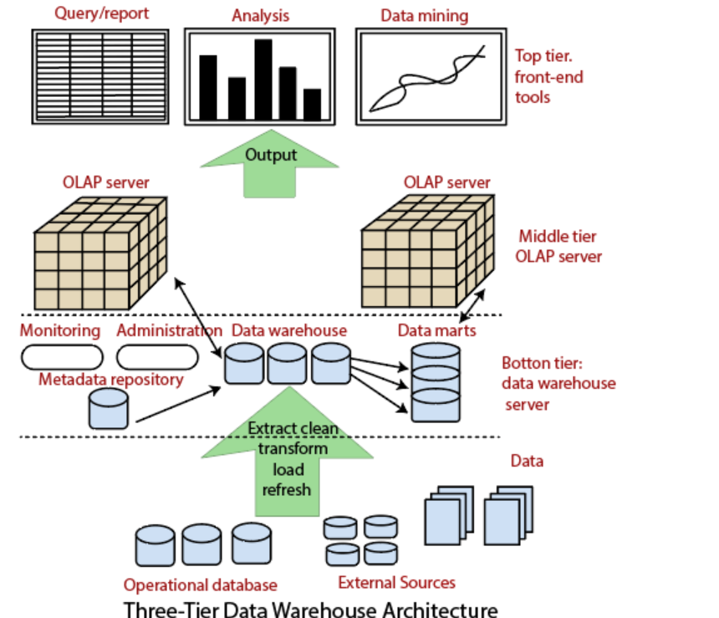
Architecture:

Slide 9
Condt
Database of the DW server
It is usually relational DBMS
Fetch only relevant information based on data mining request .
Data is cleaned , transformed and loaded into this layer using back end tools (ETL)
Function provided by back end tools are:
Data extraction
Data cleaning
Data transformation
Data load
Data refresh

Slide 10
Component in Data Warehouse
Data Warehouse
Meta Data-data about data , defining DW
- Used for building and maintaining and managing DW
-Includes : Data name, definition, source of data, algorithm used for cleaning ….
For Example: 103 NK78 30000
Model No:103 ; NK78-Agent ID no ; Total sales-3000;

Slide 11
Condt
Technical Meta Data- contains information about DW
-used by database designer and administrators
Business Meta Data-contains information about data ,
- used by end user
- without meta data we cant conclude , what its represent

Slide 12
COndt
3.Data Mart:- Subsidiary of data warehouse ,contain small slice of data
Example: single department data
Dependent :sourced directly from DW
Independent: Sourced from one or more database
4.Monitoring and administration:
Includes refreshment and data recovery
Limiting the size of DW controlling the number and ranges of queries, manage the data base performance

Slide 13
Condt
Middle Tier: OLAP server
Concept of multidimensional database
It allows users to analyze the data using multidimensional views
OLAP Server Implemented by two models: ROLAP
MOLAP

Slide 14
Condt
Top Tier: Front ends Tools/ Front End client Layer
Query tool and report tool: production of report
Query tool: creation of SQL
Application dependent tool:
Data mining Tool:

Slide 15
Multidimensional Data Model
OLAP Cube –Data structure used quick data analysis
ETL tools- Data’s loaded into OLAP Cube
4 operations:
1.Roll-up(drill –up)
- Uses the concept of Hierarchy
Profit of company
Profit from cloths
Profit from electronics
Profit from kitchen item

Slide 16
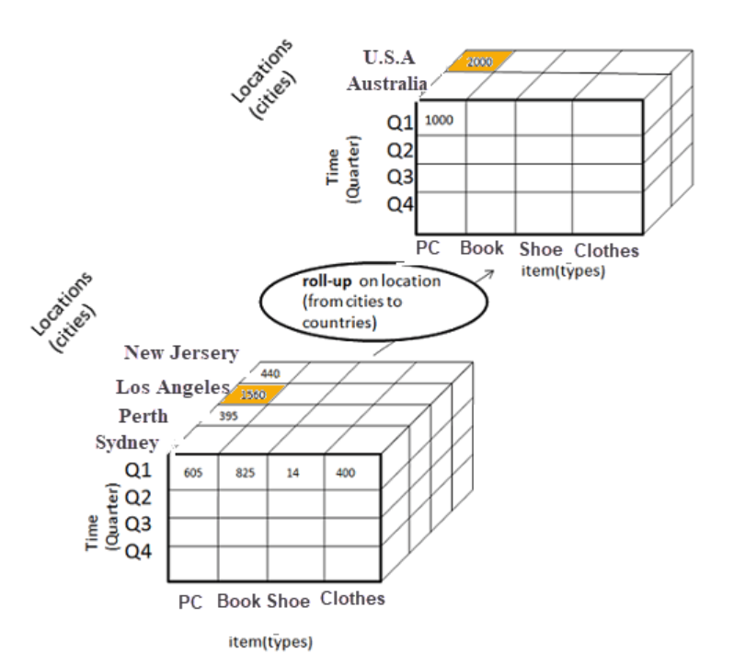
condt

Slide 17
condt
Drill Down-
-Reverse of drill up
- data is drilled down
Profit of company
Profit from cloths
Profit from electronics
Profit from kitchen

Slide 18
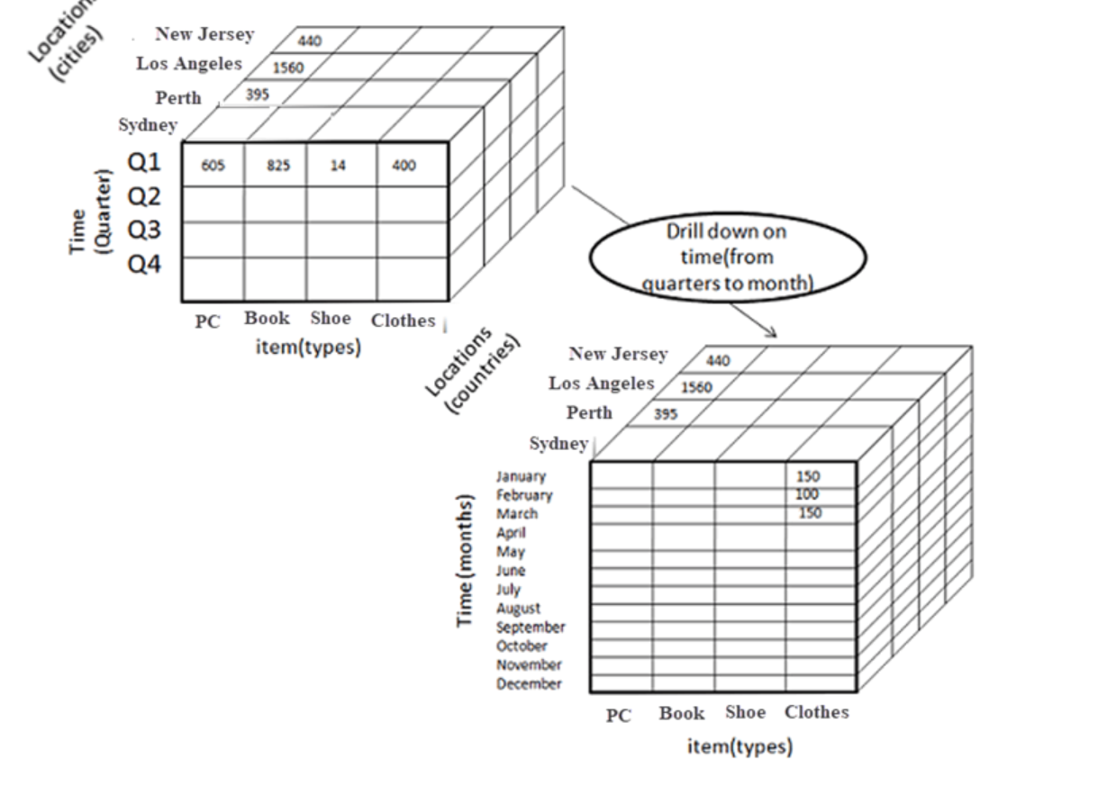
condt

Slide 19
Condt
Slice :
Data cube is sliced and information is divided and new cube’s is formed
Dimension Time is Sliced with Q1 as the filter.
A new cube is created altogether.

Slide 20
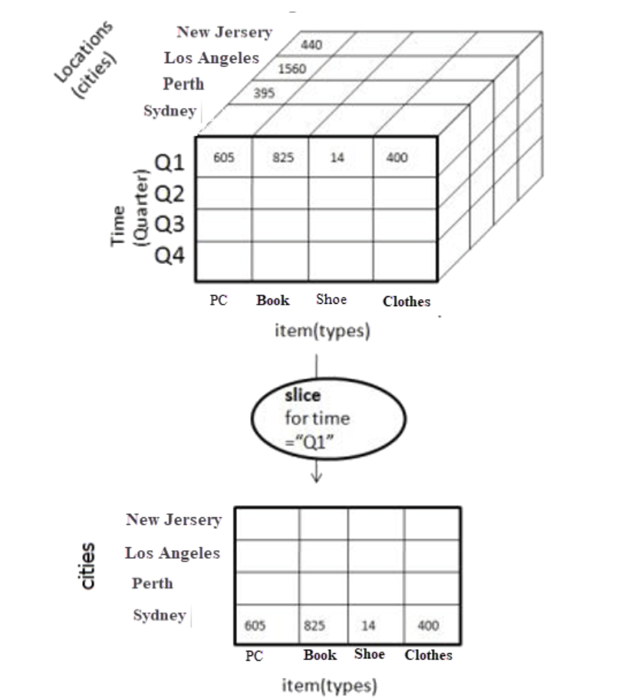
condt

Slide 21
Condt
Dice:
This operation is similar to a slice. The difference in dice is you select 2 or more dimensions that result in the creation of a sub-cube.

Slide 22
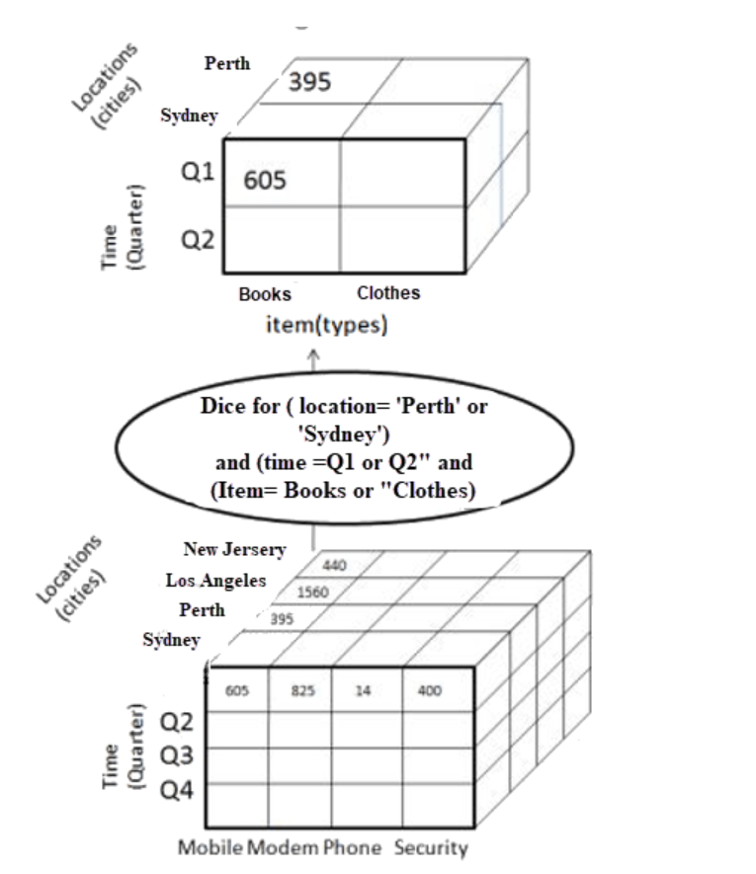
condt

Slide 23
Condt
4) Pivot
In Pivot, you rotate the data axes to provide a substitute presentation of data.
In the following example, the pivot is based on item types.

Slide 24
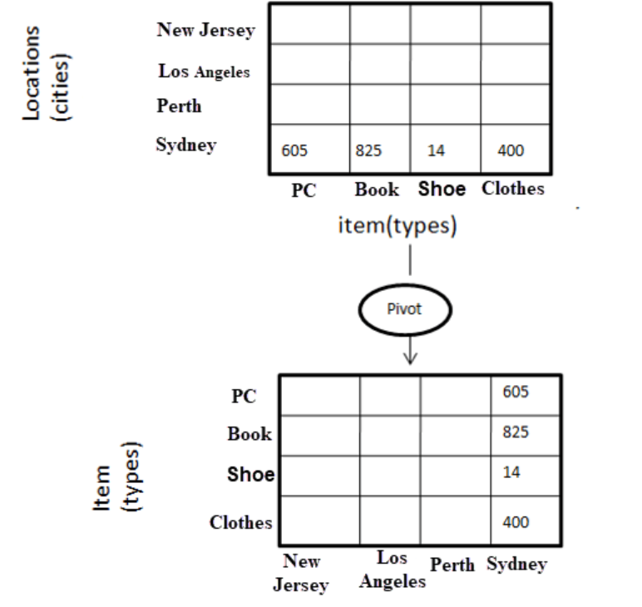
condt

Slide 25
OLAP SERVER TYPES
ROLAP
MOLAP
HOLAP
ROLAP:
- Relational OLAP
Tools can analyze large amount of data
ROLAP tools store and analyze volatile data
Expertise person can deal with ROLAP
Dis adv: Poor query performance

Slide 26
condt
MOLAP:
-Multidimensional OLAP
-MOLAP easy to use
-Information retrieval is fast
-Can perform complex computation
HOLAP:
-Hybrid OLAP
-Complex computation
-large amount data

Slide 27
Data Pre-processing
It is done to improve the quality of data in data warehouse
Data cleaning
-Process of removal of incorrect, incomplete ,inaccurate data (Noisy data)
-replacing missing data

Slide 28
COndt
Ways to handle the missing data during cleaning:
- Manual Entry of missing data
Using attribute “ MEAN”
Using Attribute”Medium”
Using “Most probable value “
Using global constant [NA]
Ignore that tuple

Slide 29
Condt
Noisy Data:
Binning:
Data:10,2,19,18,20,18,25,28,22
Sort:2,10,18,18,19,20,22,25,28
2,10,18
18,19,20
22,25,28
Bin Size =3

Slide 30
condt
Smoothing by BIN Mean
Value of bin is replaced by mean Value(Average )
2, 10,18-----2+10+18=30/3=10
18,19,20------18+19+20=57/3=19
22,25,28-------22+25+28=75/3=25
10,10,10
19,19,19
25,25,25

Slide 31
Condt
Smoothing by Medians
Odd=n+1/2
Even=n/2
10,10,10
19,19,19
25,25,25

Slide 32
Condt
Smoothing by Bin Boundaries:
Two Min and Max value
2,10,18
18,19,20
22,25,28
2, 2, 18
18 18 20
22 22 28

Slide 33
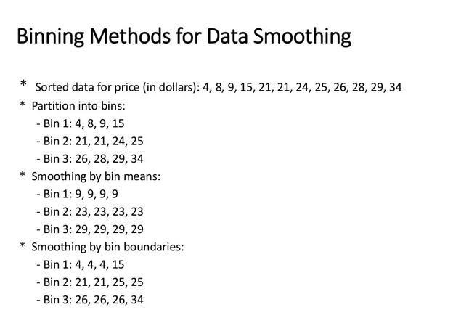
condt

Slide 34
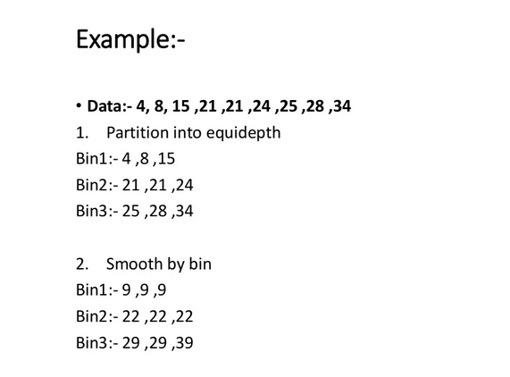
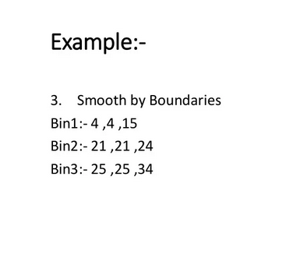
condt

Slide 35
condt
(II) Regression
-fitting data into function
-Linear Regression- fit two attributes
-Multiple linear regression –more than two attributes fitted into multidimensional surface
(iii)Clustering
-Similar values are organized into groups
-values that fall outside the clusters may be considered outlier

Slide 36
Data Integration
It is preprocessing method that involves merging of data from different sources in order to form a data store like data warehouse.
Issues in Data Integration:
Schema integration and object matching
Redundancy – unwanted attributes (Derived from other attributes)
Detection and resolution of data value conflicts

Slide 37
Data transformation
It is data pre-processing technique that transform the data into alternative forms appropriate for mining .
Techniques:
Smoothing-Removing noise from data[binning by mean, medium, boundary, regression, clustering ]
Aggregate –summary or aggregate function [constructing a data cube]
Generalization-lower level concept are replaced with higher level
Normalization- attribute’s values are normalized by scaling their values . So that they fall in specified range

Slide 38
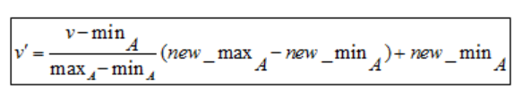
Condt.
Min – Max Normalization:
Z-score normalization:

Slide 39
condt
marks
8
10
15
20
Min:
The minimum value of the given attribute. Here Min is 8
Max:
The maximum value of the given attribute. Here Max is 20
V: V is the respective value of the attribute. For example here V1=8, V2=10, V3=15, and V4=20
newMax:
1
newMin:
0

Slide 40
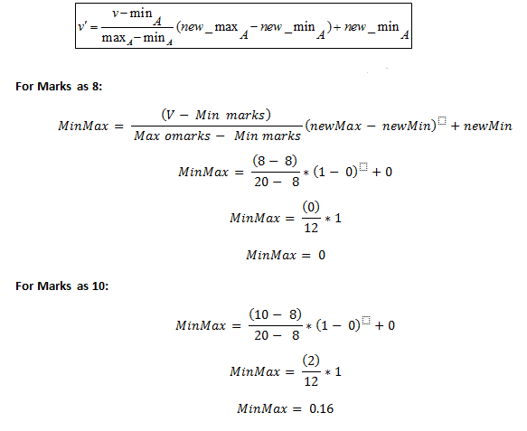
condt

Slide 41
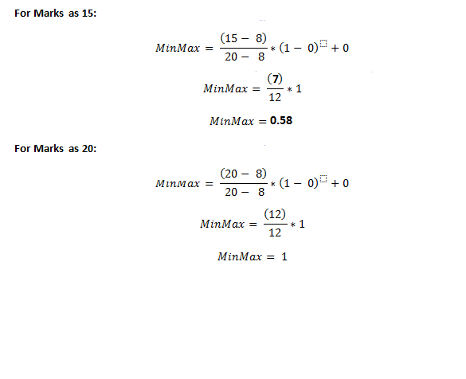
condt

Slide 42
condt
marks | marks after Min-Max normalization
8 | 0
10 | 0.16
15 | 0.58
20 | 1

Slide 43
Problem 2
Suppose we have to normalize the following data set, 200, 300, 400, 600, 1000 to a new range [0, 1], then using min-max normalization
min = 200, max = 1000, new_min = 0, new_max = 1

Slide 44
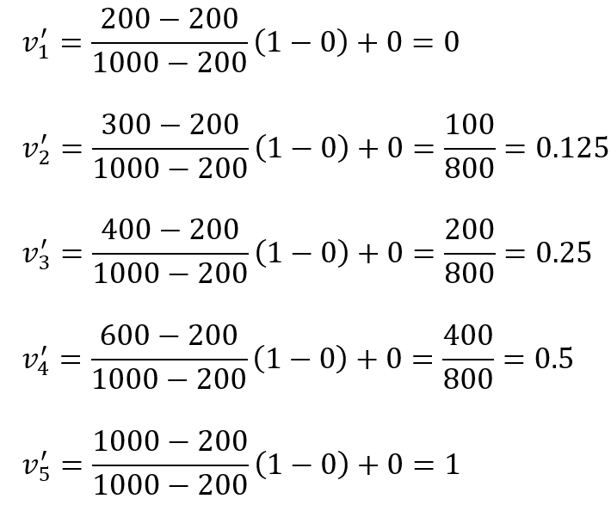
condt

Slide 45
condt
Zero- Score Normalization
New value = (x – μ) / σ
x: Original value
μ: Mean of data
σ: Standard deviation of data

Slide 46
condt
How to calculate Z-Score of the following data?
marks
8
10
15
20

Slide 47
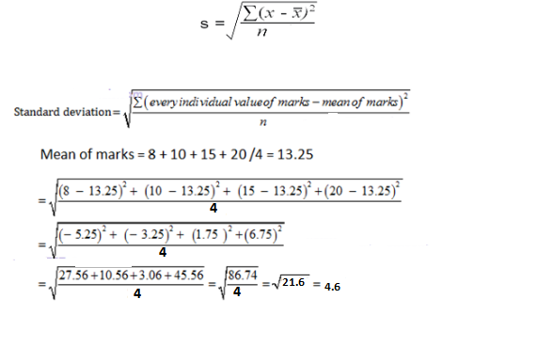
condt

Slide 48
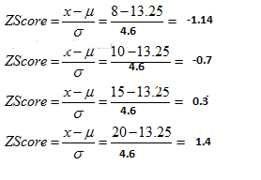
condt
Mean = 13.25
Standard deviation = 4.6

Slide 49
condt
marks | marks after z-score normalization
8 | -1.14
10 | -0.7
15 | 0.3
20 | 1.4

Slide 50
condt
marks | marks after z-score normalization
8 | -1.14
10 | -0.7
15 | 0.3
20 | 1.4

Slide 51
Problem 2
we have to normalize the following data set, 200, 300, 400, 600, 1000 then using Z-Score normalization

Slide 52
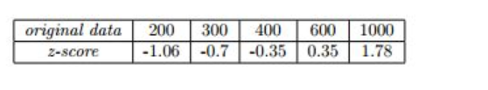
condt

Slide 53
Decimal Scaling
A value v of attribute A is can be normalized by the following formula
Normalized value of attribute = ( v^{i} / 10^{j} )
Example of Decimal scaling :
CGPA | Formula | CGPA Normalized after Decimal scaling
2 | 2/10 | 0.2
3 | 3/10 | 0.3

Slide 54
Data Reduction
Reduced representation of dataset from the available dataset.
Why data reduction? — A database/data warehouse may store terabytes of data. Complex data analysis may take a very long time to run on the complete data set
Easy visualization
Improve computation time and space
Remove irrelevant /noisy data
-Integrity of the original data should be maintain even after reduction in data volume
-It should produce same analytics result as on original data.

Slide 55
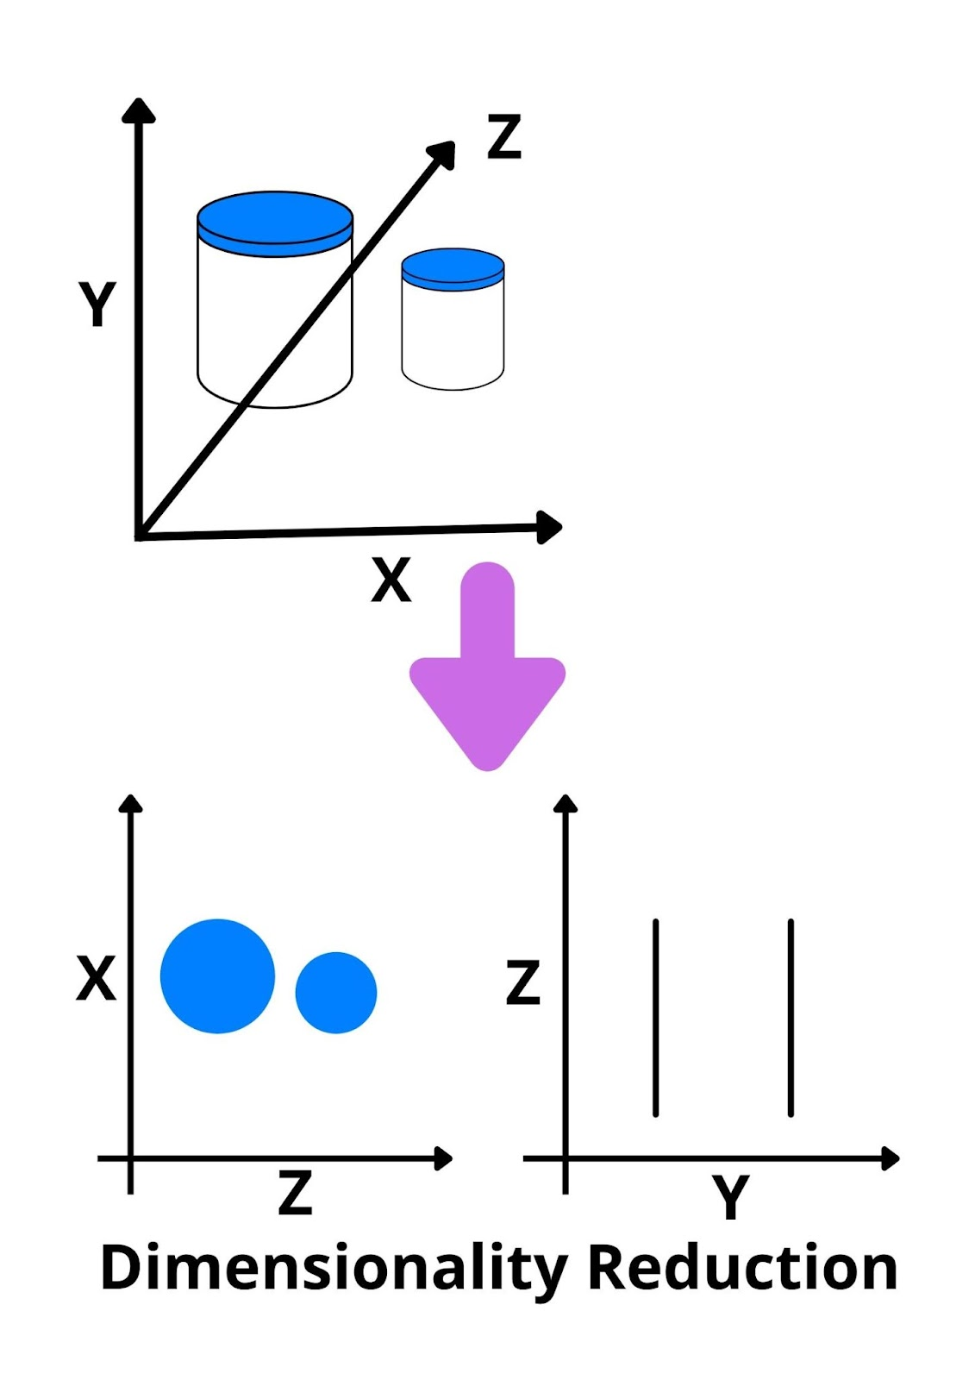
condt

Slide 56
Condt
Dimensionality reduction: Remove redundant attributes
-weakly important data is removed.
-remove outdated or redundancy data.
Two type:
Attribute selection/ feature selection(Subset selection)
{x1,x2} choose one out of two
{x1,x2,x3} choose two out of three
{x1,x2},{x2,x3},{x3,x1}…

Slide 57
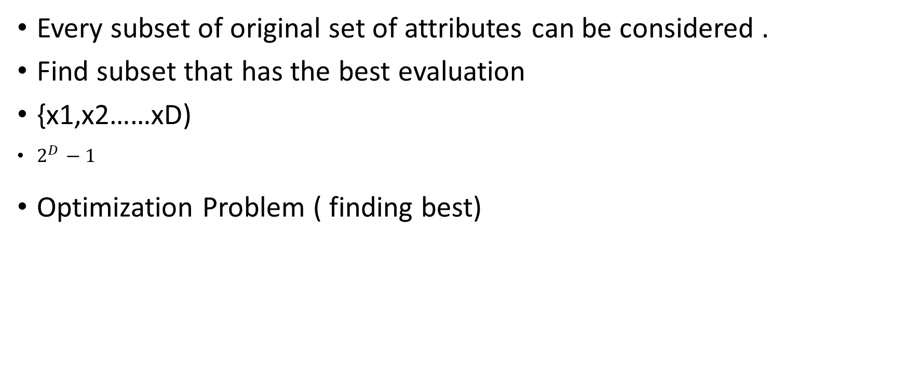
Condt
Every subset of original set of attributes can be considered .
Find subset that has the best evaluation
{x1,x2……xD)
$2^{D }−1$
Optimization Problem ( finding best)

Slide 58
Numerosity Reduction – Data is replaced by estimated value / alter value
Data replaced with mathematical models or smaller form of representation of the data instead of actual data.
Parametric
Non-Parametric

Slide 59
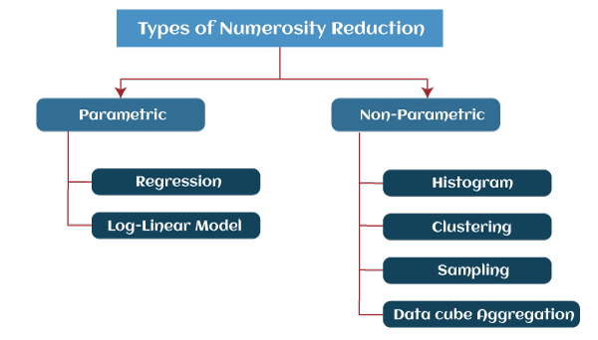
condt

Slide 60
Condt
Parametric: model into which the data fits
y = wx+b
Non Parametric: Not using model
Histogram, Clustering, Sampling, Data Cube Aggregation, Data Compression.

Slide 61
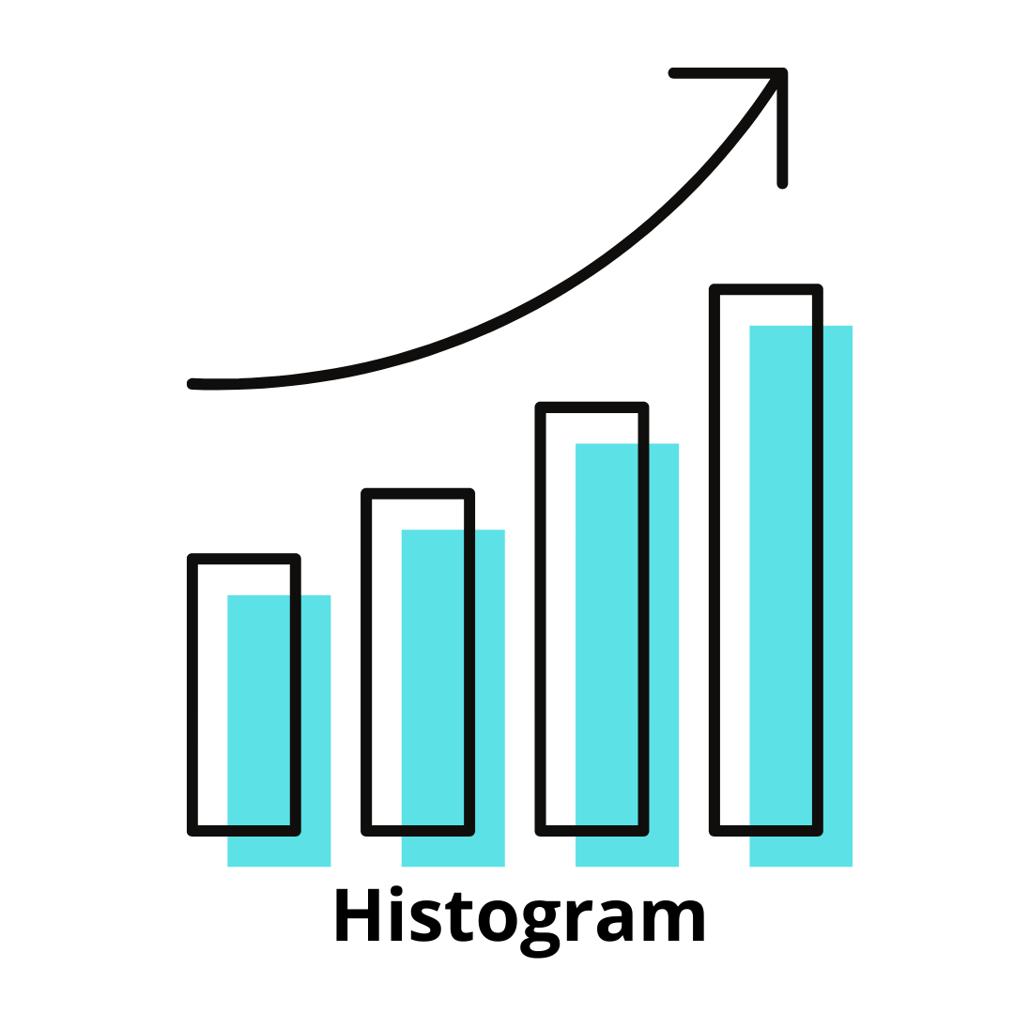
condt
Histograms
divisions the data distribution n of A into disjoint subsets, or buckets
A histogram is a graph that represents frequency distribution which describes how often a value appears in the data

Slide 62
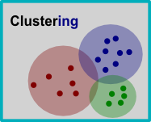
condt
Clustering:
Clustering techniques groups similar objects from the data so that the objects in a cluster are similar to each other, but they are dissimilar to objects in another cluster.
The quality of the cluster depends on the diameter of the cluster, i.e., the max distance between any two objects in the cluster.
Sampling: One of the methods used for data reduction is sampling, as it can reduce the large data set into a much smaller data sample

Slide 63
condt
Data Cube Aggregation:
It is a process in which info is gathered and expressed in summary form
Dataset represented in smaller volume

Slide 64
condt
Data Compression –Encoding of data
-Lossless data reduction –compressed data can reconstructed to form original data without losing any information
-Loss data reduction- Unable to reconstruct the original data from compressed one

Slide 65

PCA(Principal Component Analysis)
Step 1:data set 1:
Step 2: mean of variable
$$X_{i}=1/N(X_{i1 }+X_{i2 }+……………X_{iN }$$
Step 3: Calculate covariance matrix
Covariance of all Pair ($X_{i} ,$ $X_{j})$
COV($X_{i}, X_{j})=\frac{1}{N−1}\sum_{k=1}^{N}{(}X_{ik}−\overline{X_{i }})(X_{jk}−\overline{X_{j }})$
Example 1 | Example 2 | Example 3 | Example 4 | exampleN
X1 | X11 | X21 | X31 | X1N
X2 | X12 | X22 | X32 | XnN

Slide 66
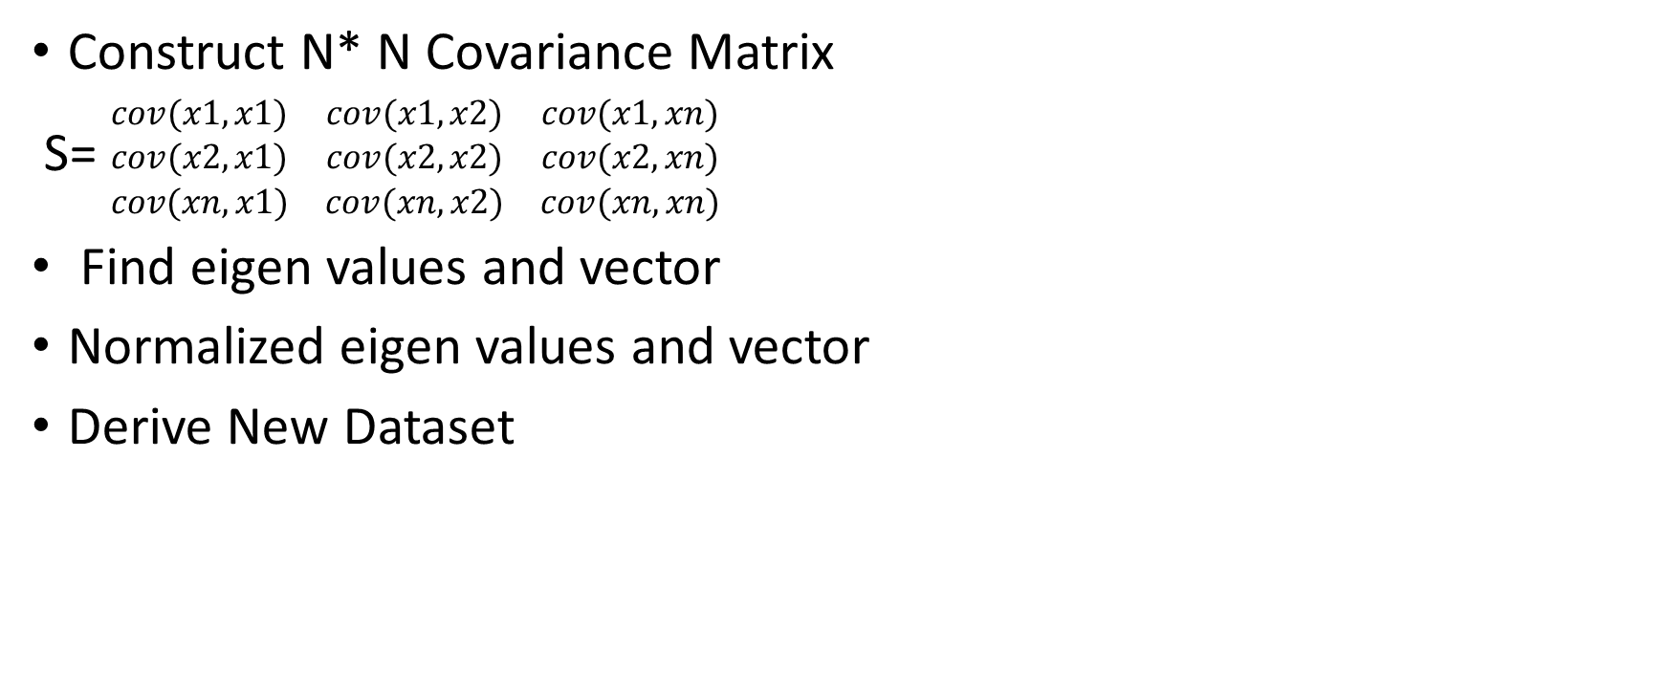
condt
Construct N* N Covariance Matrix
S= $\begin{matrix}cov(x1,x1) & cov(x1,x2) & cov(x1,xn) \\ cov(x2,x1) & cov(x2,x2) & cov(x2,xn) \\ cov(xn,x1) & cov(xn,x2) & cov(xn,xn)\end{matrix}$
Find eigen values and vector
Normalized eigen values and vector
Derive New Dataset

Slide 67
Example
Given Following Data use PCA to reduce the dimension from 2 to 1
Step1:
No of Features: n=2
No. of sample: N=4
Features | Ex1 | Ex2 | Ex3 | Ex4
X | 4 | 8 | 13 | 7
Y | 11 | 4 | 5 | 14

Slide 68

condt
Step 2:
Mean($\overline{X_{j }}=4+8+13+7$)/4=8
Mean($\overline{Y_{j }}=11+4+5+14$)/4=8.5
Step 3:
Computation of covariance Matrix
(x,y)=(x,x)(x,y)(y,x)(y,y)
Cov(x,x)= 1/N-1 $\sum_{k=1}^{N}{(xi−}\overline{X_{ })2}$

Slide 69
Module -2 Data Mining Concepts
Introduction to Data Mining:
-Discovering or mining or extracting knowledge or pattens from a large amount of data.
-Extracting significant data
-KDD(Knowledge discover from data)
-Exploratory data analysis or data driven or deductive learning
--Knowledge discovery in data or knowledge extraction

Slide 70
Condt
Need of Data mining:
-Finding hidden information from data
-Extracting useful information
-Automatic data analysis

Slide 71
Application Of DM
Customer segmentation:
-Used in Business
Market Basket Analysis
-Retail Shop
Risk Management
-loan Company- Uncover risks associated with customer
Fraud detection
Credit card companies
Demand prediction
- Predict in advance

Slide 72
Data Mining Tasks
Predictive
The main goal of this mining is to say something about future results not of current behavior
-predict value of data by make use of past data.
-It determines, what can happen in the future with the help past data analysis.
what will happen next?
what is the outcome if these trends continue?
what actions are required to be taken?

Slide 73
cond
Descriptive
-It determines, what happened in the past by analyzing stored data.
what happened?
where exactly is the problem?
what is the frequency of the problem?

Slide 74
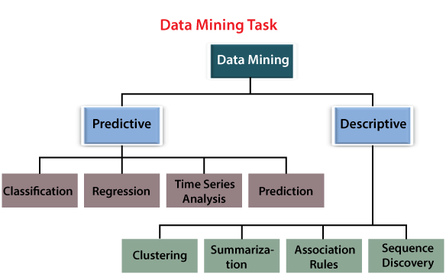
condt

Slide 75
Condt
Classification:
-A data item into one of those several pre- defined classes
(Credit card application)
bank loan officer wants to analyze the data in order to know which customer (loan applicant) are risky or which are safe.
A marketing manager at a company needs to analyze a customer with a given profile, who will buy a new computer.
In both of the above examples, a model or classifier is constructed to predict the categorical labels. These labels are risky or safe for loan application data and yes or no for marketing data.

Slide 76
condt
Regression :
-statistical model used to predict relationship between independent and dependent.
-Regression analysis is used for prediction and forecasting.
-Y=mx+c Y is dependent variable, x is independent variable
= How the values of y changes w.r.t in x
Ex: forecast pricing and sales of the product
Ex:pension

Slide 77
Condt
Time series Analysis:
Data taken at specified times usually at equal intervals
Predict future values based on past values
Stock Market
Prediction:
-Predict future value based on current data
Prediction correct treatment for a person based on their medical condition
Ex:Flood

Slide 78
Condt
Descriptive Analysis:
-Describes about data
-Pattern and relationship in data
-summarizing and converting data into usable information for reporting and monitoring.
-Clustering Analysis: It is the process of determining which data sets are similar to one another
Grouping data without known label
-

Slide 79
condt
Sequence Discovery:
Hidden patten in data (Based on time series)
Summarization Analysis:
summarizing a large number of items related to Christmas season sales provides a general description of the data
Association Rules Analysis:
Discovery of interesting relationships between various variables in large databases.

Slide 80
Data Mining Functionality
Used to find specific pattern in data
Class/Concept Descriptions:
-Data can be associated with classes or concept
-concepts refers to a collection of data item such as printer, computers..
-how to describe these items?
Data characterization
Data discrimination
both

Slide 81
ondt
Data characterization- summarizing the general characteristics of a target class of data.
Ex: summarizing the characteristics of customers who spend more than 1lak a year at shop
Result can be general profile of customer, such as monthly income above 5lak, employed, have excellent credit score..
Data Discrimination- comparing the target class with one or set of class
It compares features of a class with features of one or more contrasting classes.g., bar charts, curves and pie charts.

Slide 82
condt
Mining Frequent patterns, Associations and correlations
-Frequent itemset: a set of items that frequently appear together in a transactional data set (Milk and Sugar)
- Frequent Subsequence: A pattern that customers tend to purchase product A, followed by a purchase of product B.
Ex: buying a phone followed by a cover.
Frequent substructure:
It refers to the various types of data structures that can be combined with an item set or subsequences, such as trees and graphs.

Slide 83
Condt
Association Analysis:
-Find Frequent Patterns –
Buys(X,”computer”)=>buys(Software) [ support=1%,Condidence=50%]
Correlation Analysis:
Correlation is a mathematical technique for determining whether and how strongly two attributes is related to one another.
Association between two or more variables and makes inferences about the strength of the relationship.

Slide 84
cont
Classification and prediction:
Classification is a data mining technique that categorizes items in a collection based on some predefined properties.
It uses methods like if-then, decision trees or neural networks to predict a class or essentially classify a collection of items.
Cluster Analysis
Similar data are grouped together, with the difference being that a class label is not known.
Clustering algorithms group data based on similar features and dissimilarities.

Slide 85
condt
Outlier Analysis:
An outlier analysis of the data that cannot be grouped into any classes by the algorithms is pulled up.
Data that do not comply with general behavior or model

Slide 86
Classification of DM
Classification Based on the Databases Mined
We can classify a data mining system according to the kind of databases mined.
Database system can be classified according to different criteria such as data models, types of data, etc. And the data mining system can be classified accordingly.
For example, if we classify a database according to the data model, then we may have a relational, transactional, object-relational, or data warehouse mining system

Slide 87
condt
Classification Based on the type of Knowledge Mined
Characterization
Discrimination
Association and Correlation Analysis
Classification
Prediction
Outlier Analysis

Slide 88
Condt
Classification Based on the Techniques Utilized
-We can classify a data mining system according to the kind of techniques used.
-ML, statistics, neural network….
Classification Based on the Applications Adapted
Data mining systems classified based on adapted applications adapted are as follows:
Finance
Telecommunications
DNA
Stock Markets
E-mail

Slide 89
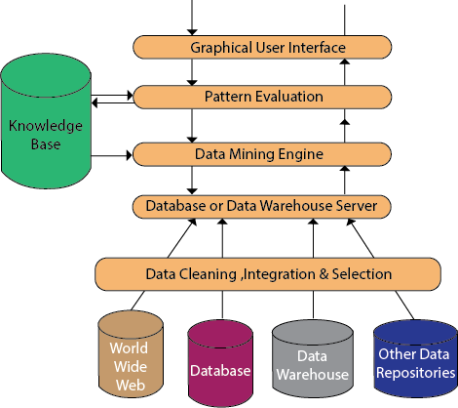
Data Mining Architecture

Slide 90
Condt
Data Sources
There are so many documents present. That is a database, data warehouse, World Wide Web (WWW).
That are the actual sources of data. Sometimes, data may reside even in plain text files or spreadsheets. World Wide Web or the Internet is another big source of data.
Different Processes
The data needs to be cleaned, integrated and selected before passing it to the database or data warehouse server. As the data is from different sources and in different formats, it cannot be used directly for the data mining process because the data might not be complete and reliable.
So, first data needs to be cleaned and integrated. Again, more data than required will be collected from different data sources and only the data of interest needs to be selected and passed to the server.

Slide 91
Condt
Database or Data Warehouse Server
The database server contains the actual data that is ready to be processed. Hence, the server handles retrieving the relevant data. That is based on the data mining request of the user.
Data Mining Engine
In data mining system data mining engine is the core component. As It consists a number of modules. That we used to perform data mining tasks.
That includes association, classification, characterization, clustering, prediction, etc.

Slide 92
condt
Graphical User Interface
We use this interface to communicate between the user and the data mining system. Also, this module helps the user use the system easily and efficiently. They don’t know the real complexity of the process.
When the user specifies a query, this module interacts with the data mining system. Thus, displays the result in an easily understandable manner.

Slide 93
condt
Knowledge Base:
-Guide the search or evaluate interestingness of resulting pattern
_get domain knowledge
-interesting constrains, thresholds, metadata.
-guiding the search for the result patterns
-objective of the knowledge base is to make the result more accurate and reliable.
Pattern Evaluation:
-They are responsible for finding interesting patterns in the data and sometimes they also interact with the database servers for producing the result of the user requests.

Slide 94
Integration of data mining with database
-Integration – Combining / Association
-We have 4 integration schema :
-No coupling
-Loose Coupling
-Semi−tight Coupling
-Tight coupling

Slide 95
Condt
No Coupling − No coupling means that a DM system will not utilize any function of a DB or DW system.
It may fetch data from a particular source (such as a file system), process data using some data mining algorithms, and then store the mining results in another file.
Loose coupling means that a Data Mining system will use some facilities of a Database or Data warehouse system, fetching data from a data repository managed by these systems, performing data mining, and then storing the mining results either in a file or in a designated place in a Database or Data Warehouse.

Slide 96
Condt
Semi-Tight Coupling
-Efficient implementations of a few essential data mining primitives (identified by the analysis of frequently encountered data mining functions) can be provided in the Database/Data Warehouse system.
Tight Coupling-
-Tight coupling means that a Data Mining system is smoothly integrated into the Database/Data Warehouse system.
-Most efficient among all

Slide 97
Major issues in Data mining.
Mining Methodology and User Interaction
Performance Issues
Diverse Data Types Issues

Slide 98
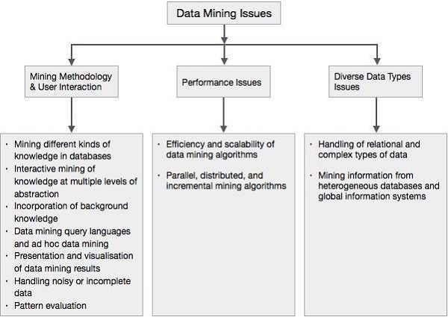
condt

Slide 99
Condt
Mining different kind of knowledge:
-DM should cover a wide spectrum of data analysis and knowledge discovery task
-Enable to use the database in different ways
-Require the development of numerous data mining techniques.
Interactive mining of knowledge at multiple levels of abstraction
-The data mining process needs to be interactive because it allows users to focus the search for patterns, providing and refining data mining requests based on the returned results.

Slide 100
Incorporation of background knowledge − To guide discovery process and to express the discovered patterns, the background knowledge can be used.
Background knowledge may be used to express the discovered patterns not only in concise terms but at multiple levels of abstraction.
Data mining query languages and ad hoc data mining
-High level query languages need to develop
-Should be integrated with a DB/BW query language

Slide 101
Condt
Presentation and visualization of data mining results
Knowledge should be easily understood and directly
High level language , visual representation or other expressive forms
Handling noisy or incomplete data :
Require data cleaning methods and data analysis methods that can handle noisy data .
If the data cleaning methods are not there then the accuracy of the discovered patterns will be poor.

Slide 102
Condt
Performance Issues:
-Efficiency and scalability of data mining algorithms
Huge amount of data
Running time must be predictable and acceptable
Parallel, distributed, and incremental mining algorithms
-Divide data into partitions and proceed in parallel

Slide 103
Condt
Diverse Data Types Issues
Handling of relational and complex types of data-
The database may contain complex data objects, multimedia data objects, spatial data, temporal data etc. It is not possible for one system to mine all these kind of data.
Mining information from heterogeneous databases and global information systems
The data is available at different data sources on LAN or WAN. These data source may be structured, semi structured or unstructured. Therefore mining the knowledge from them adds challenges to data mining.

Slide 104
Module -3 Frequent Pattern Mining
Frequent Pattern:
-A pattern( a set of items, sub sequences, substructure… that occurs frequently in a data sets.
Motivation:
What products wear often purchased together ?
What are subsequent purchases after buying a PC?
What kind of DNA are sensitive to this new drug?

Slide 105
COndt
Market Basket Analysis :
-Process of analysing customer buying habits by finding the association between different items.
-useful for seller
Placing them together
Arranging item

Slide 106
Condt
Frequent pattern are represented by Association Rules.
Eg( computer and Anti- virus)
Computer=>Antivirus software[support 2%, confidence 60%]
[Among all the transaction, 2% transaction will shows that computer and antivirus are purchased together]
Support:
-Identifies how frequently a rule is applied to given dataset
-S(PUQ)= (PUQ)/N or No of transaction involving itemset/Total of transaction
N= Total No of transaction

Slide 107
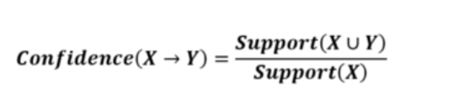
COndt
Confidence:
-It is the likelihood or trustworthiness of association rule.
-how often our rule was valid
-Defines frequent occurrence of items of Q in transactions of Q
C(P=>Q)= P(B/A)

Slide 108
Frequent Mining Pattern
Scalable mining methods: Three major approaches
Apriori (Agrawal & Srikant@VLDB’94)
Freq. pattern growth (FPgrowth—Han, Pei & Yin @SIGMOD’00)
Vertical data format approach (Charm—Zaki & Hsiao @SDM’02)

Slide 109
Condt
Method:
Initially, scan DB once to get frequent 1-itemset
Generate length (k+1) candidate itemset from length k frequent itemsets
Test the candidates against DB
Terminate when no frequent or candidate set can be generated

Slide 110
The Apriori Algorithm—An Example
Sup_{min} = 2
Itemset | sup
{A} | 2
{B} | 3
{C} | 3
{D} | 1
{E} | 3
Database TDB
Itemset | sup
{A} | 2
{B} | 3
{C} | 3
{E} | 3
L₁
Tid | Items
10 | A, C, D
20 | B, C, E
30 | A, B, C, E
40 | B, E
C₁
1st scan
C₂
Itemset | sup
{A, B} | 1
{A, C} | 2
{A, E} | 1
{B, C} | 2
{B, E} | 3
{C, E} | 2
C₂
Itemset
{A, B}
{A, C}
{A, E}
{B, C}
{B, E}
{C, E}
L₂
Itemset | sup
{A, C} | 2
{B, C} | 2
{B, E} | 3
{C, E} | 2
2nd scan
C₃
Itemset
{B, C, E}
3rd scan
L₃
Itemset | sup
{B, C, E} | 2

Slide 111
The Apriori Algorithm (Pseudo-Code)
C_{k}: Candidate itemset of size k
L_{k} : frequent itemset of size k
L₁ = {frequent items};
for (k = 1; L_{k} !=∅; k++) do begin
C_{k+1} = candidates generated from L_{k};
for each transaction t in database do
increment the count of all candidates in C_{k+1} that are contained in t
L_{k+1} = candidates in C_{k+1} with min_support
end
return ∪_{k} L_{k};

Slide 112
FP-Growth method
First representing frequent item into a frequent pattern tree or FP-Tree
Then divide the database into a set of conditional databases
The two primary drawbacks of the Apriori Algorithm are:
At each step, candidate sets have to be built.
To build the candidate sets, the algorithm has to repeatedly scan the database.

Slide 113
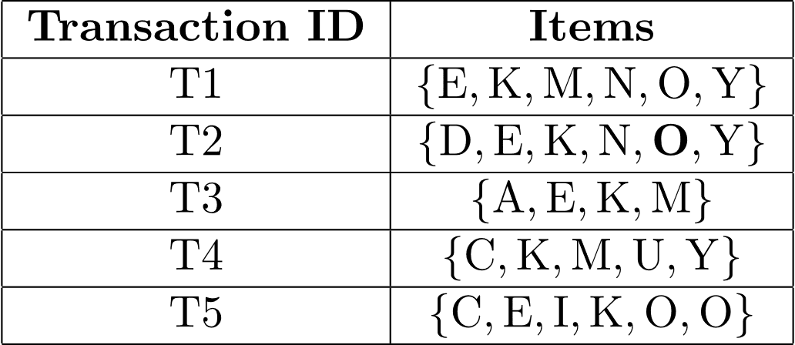
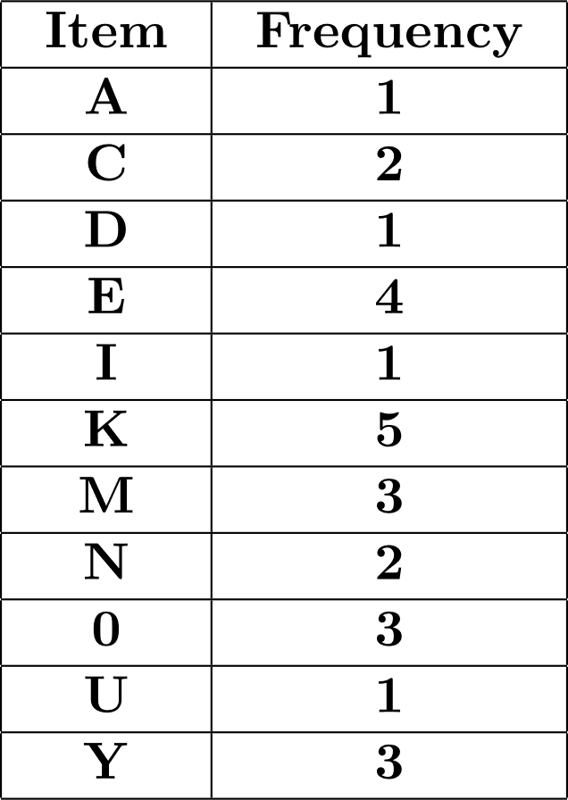
condt
The frequency of each individual item is computed

Slide 114
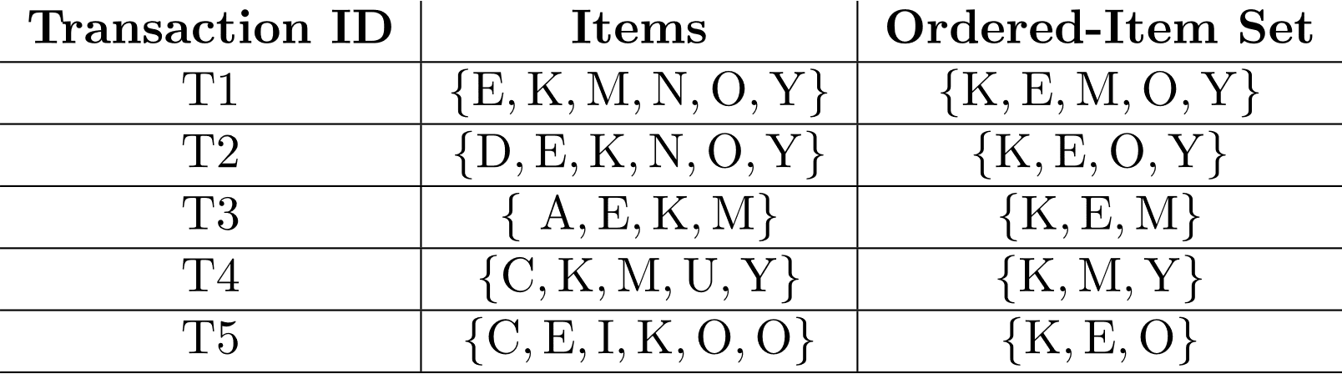
Condt
Let the minimum support be 3. A Frequent Pattern set is built which will contain all the elements whose frequency is greater than or equal to the minimum support.

Slide 115
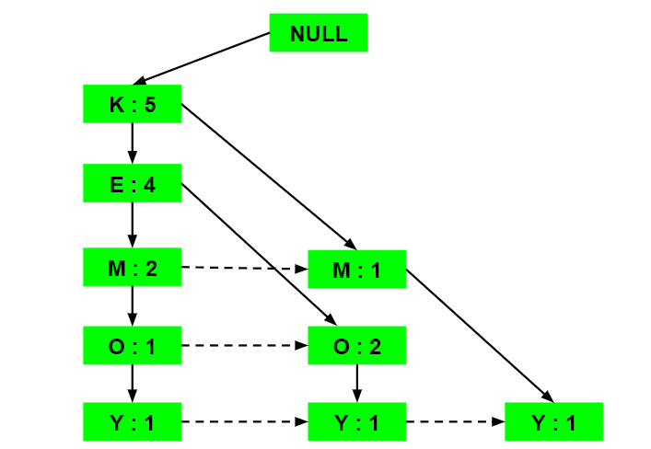
Condt

Slide 116
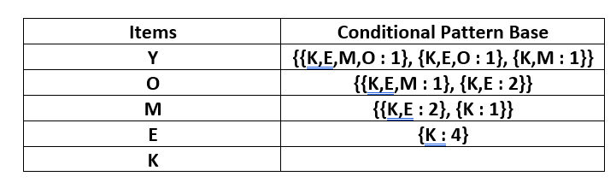
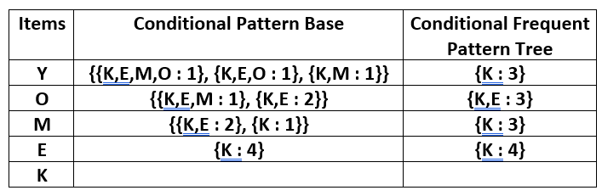
condt

Slide 117
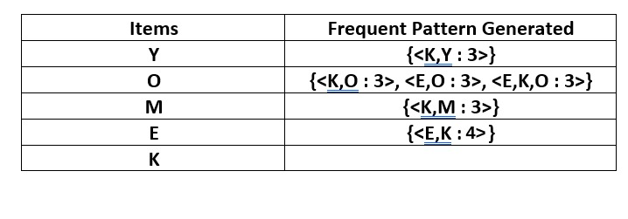
condt

Slide 118
ECLAT: Frequent Pattern Mining with Vertical Data Format
Eclat is an algorithm for discovering frequent item sets in a transaction database. It was proposed by Zaki (2001).
Eclat (Equivalence class Transformation)

Slide 119
Various Kinds of Association Rules
finds interesting associations and relationships among large sets of data items. This rule shows how frequently a itemset occurs in a transaction.
An association rule consists of two parts: an antecedent (if) and. a consequent (then)
It can be used to improve decision making in a wide variety of applications such as: market basket analysis, medical diagnosis, bio-medical literature, protein sequences, census data, logistic regression, fraud detection in web, CRM of credit card business et.
An association rule having support and confidence greater than or equal to a user-specified minimum support threshold and respectively a minimum confidence threshold.

Slide 120
CONDT
Used to analysis and predicts customer behaviour
If / then statement
Buys(onions, potatoes)=>buys(tomatoes)
bread=>butter[20 %, confident 40%]
Bread- Ancedent ,Butter-Consequent
20%-support
40%- confident

Slide 121
Condt
In super Market:
-Total transaction: 100
-Bread:20 (People are purchasing bread)
So 20/100*100=20% support
In 20 transaction, butter:9 transactions (people who are getting butter along bread)
So 9/20*100=45%confidence

Slide 122
Classification of Association Rule
Single dimensional Association Rule :
Only dimension or predicate
Bread=>butter
Multidimensional Association Rule
2 or more predicates or dimension
Occupation(I.T), Age(>22)=>buys(High Speed Laptop)

Slide 123
Condt
Hybrid Dimensional Association rule:
-With repeated dimensions or predicates
Time(5’clk),buys(tea)=>buys(biscuits)
Find the occurrence of item based on occurrence of other items in transaction ( set of itemset appear more no of times in total transaction)
{Diaper}=>{Beer}
{Milk, Beer}=>{Eggs, Coke}
{Beer, Coke}=>{Milk}

Slide 124
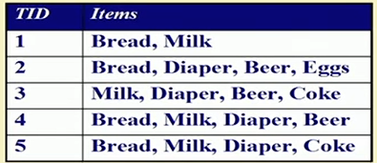
Frequent itemset
Itemset: A collection of one or more items
K-itemset: An itemset that contains k items
Frequency count:(σ)
-frequency of occurrence of itemset
-E.g (Milk ,Diaper,Bread}=2

Slide 125
Condt
Support:
Fraction of transactions that contains an itemset
(Milk ,Diaper, Bread}=2
=2/5 =40%

Slide 126

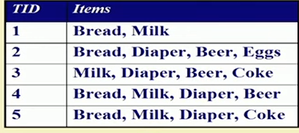
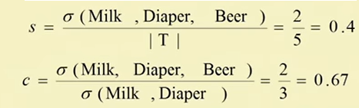
Condt
Support: Contains X and Y = Total count of Left and right (both XY appear Together/Total transaction
Confident : how often items in Y appear in transaction that contains X
=Total Count of left & Right(Both XY appear together) / left(X)

Slide 127
Correlation Analysis in Data Mining
Correlation analysis is a statistical method used to measure the strength of the linear relationship between two variables and compute their association.
A high correlation points to a strong relationship between the two variables, while a low correlation means that the variables are weakly related.
Types
Pearson correlation,
Kendall rank correlation,
Spearman correlation, and the
Point-Biserial correlation.

Slide 128
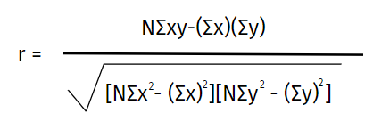
condt
Pearson r correlation
Pearson r correlation is the most widely used correlation statistic to measure the degree of the relationship between linearly related variables

Slide 129
Condt
N = the number of pairs of scores
Σxy = the sum of the products of paired scores
Σx = the sum of x scores
Σy = the sum of y scores
Σx2 = the sum of squared x scores
Σy2 = the sum of squared y scores

Slide 130
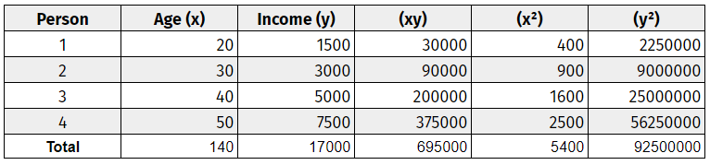
condt

Slide 131
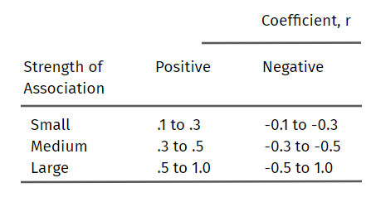
condt

Slide 132
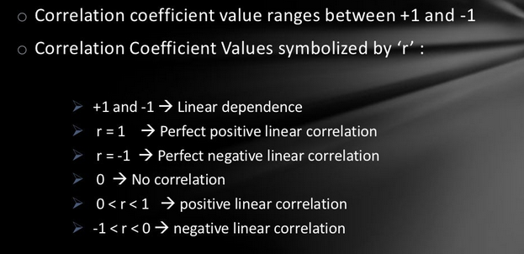
condt

Slide 133
Apriori Algorithm
Apriori algorithm is given by R. Agrawal and R. Srikant in 1994.
An iterative approach or level-wise search where k-frequent item sets are used to find k+1 item sets.

Slide 134
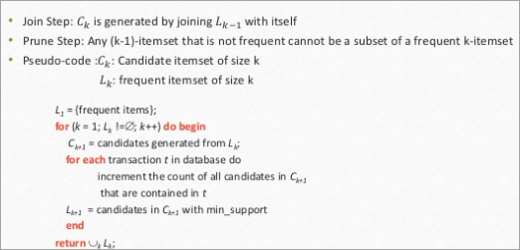
condt

Slide 135
The Apriori Algorithm—An Example
Sup_{min} = 2
Itemset | sup
{A} | 2
{B} | 3
{C} | 3
{D} | 1
{E} | 3
Database TDB
Itemset | sup
{A} | 2
{B} | 3
{C} | 3
{E} | 3
L₁
Tid | Items
10 | A, C, D
20 | B, C, E
30 | A, B, C, E
40 | B, E
C₁
1st scan
C₂
Itemset | sup
{A, B} | 1
{A, C} | 2
{A, E} | 1
{B, C} | 2
{B, E} | 3
{C, E} | 2
C₂
Itemset
{A, B}
{A, C}
{A, E}
{B, C}
{B, E}
{C, E}
L₂
Itemset | sup
{A, C} | 2
{B, C} | 2
{B, E} | 3
{C, E} | 2
2nd scan
C₃
Itemset
{B, C, E}
3rd scan
L₃
Itemset | sup
{B, C, E} | 2

Slide 136
Model-4 Classification and Prediction
Classification:
-Finding a good model that is used to predict the class of object whose class label is unknown.
-Ex: grouping of the patients based on their medical record
Prediction:
-predicting missing value / unknown value based on current past/current data.
-Ex: predicting the correct treatment for a person based on their medical condition

Slide 137
condt
Classification contains 2 steps:
Model construction / classifier
Model usage

Slide 138
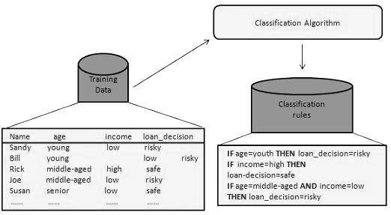
condt

Slide 139
condt
Classification is to identify the category or the class label of a new observation.
First, a set of data is used as training data. The set of input data and the corresponding outputs are given to the algorithm.
So, the training data set includes the input data and their associated class labels.
Using the training dataset, the algorithm derives a model or the classifier. The derived model can be a decision tree, mathematical formula or a neural network.

Slide 140
condt
Model Usage:
Classify unknown data samples
If the accuracy is acceptable, use the model to classify data objects whose class labels are not known
In classification, when an unlabeled data is given to the model, it should find the class which it belongs to.
The new data provided to the model is the test data set.

Slide 141
condt
Predicts categorical class labels
Example: Typical Applications
{credit history, salary} credit approval ( Yes/No)
{Temp, Humidity} Rain (Yes/No)
A set of documents sports, technology, etc.

Slide 142
condt

Slide 143
Condt
Common Techniques
K-Nearest Neighbor (kNN) - Use k closest training data samples to predict category.
Decision Trees (DTree)- Construct classification trees based on training data.
Neural Network
Support Vector Machines (SVMs).

Slide 144
Decision Tree Induction
Flow chart like tree structure
Support for making decision
Defines rules in forms of form of tree
Supervised approach
Types of Node:
Root Node – Main question
Branch Node-intermediate decision
Leaf Node- Answer

Slide 145
Condt

Slide 146
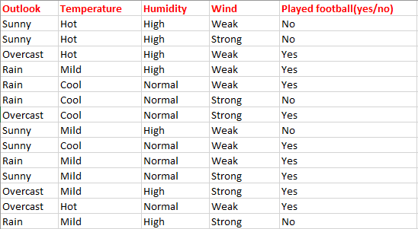
condt

Slide 148
condt
Information Gain
Entropy

